Slide 1
Installing Debian on Virtualbox
Matti Murtomäki

Slide 2
Create a new virtual machine
Downloading VirtualBox installer
VirtualBox 7.0.2 platform packages
Downloaded for Windows hosts
There where priviledge issues install the machine in Haaga-helia’s virtual machine
Installing the software in my home Windows 10 OS

Slide 3
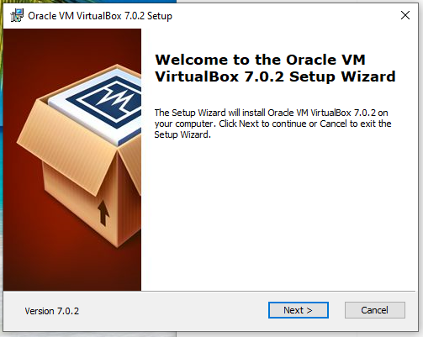
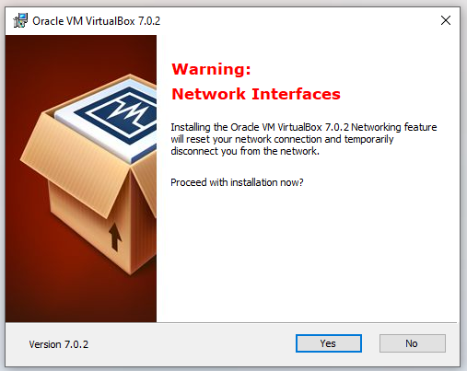
Installing the VM

Slide 4
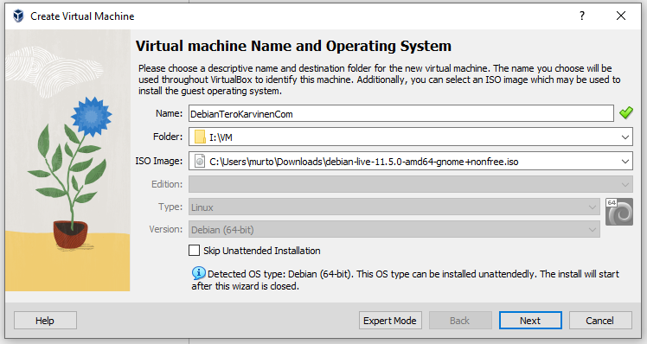
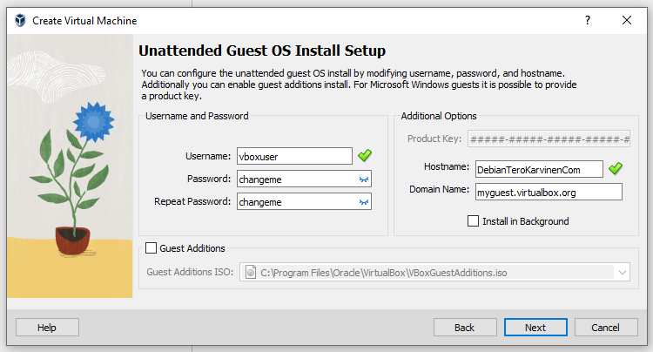
Installing the VM
Choosing the right image

Slide 5
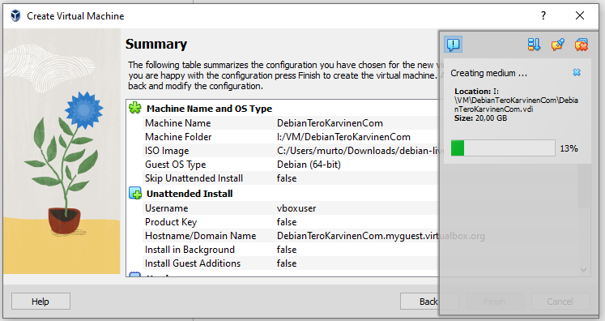
Installing the VM

Slide 6
VM didn’t work
Configuring Boot settings for computer
In order to start VM on home pc virtualization should be enabled on

Slide 7
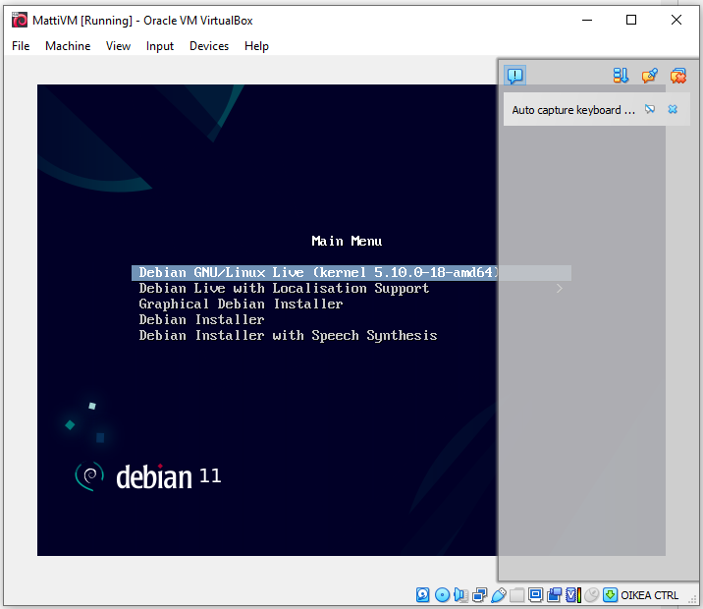
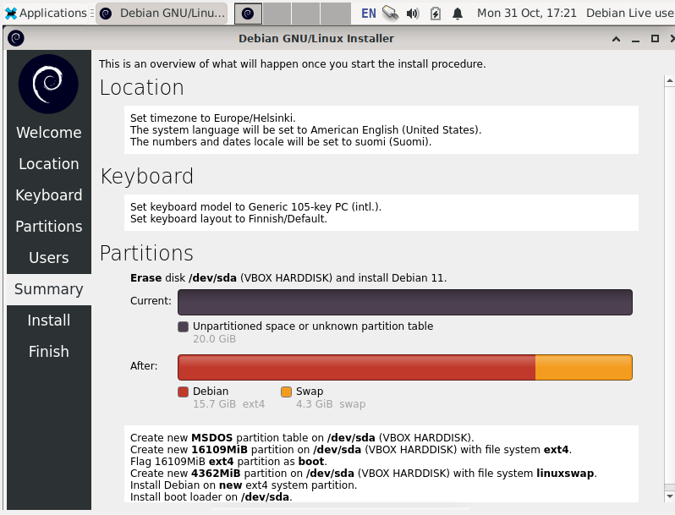
Starting and installing Debian

Slide 8
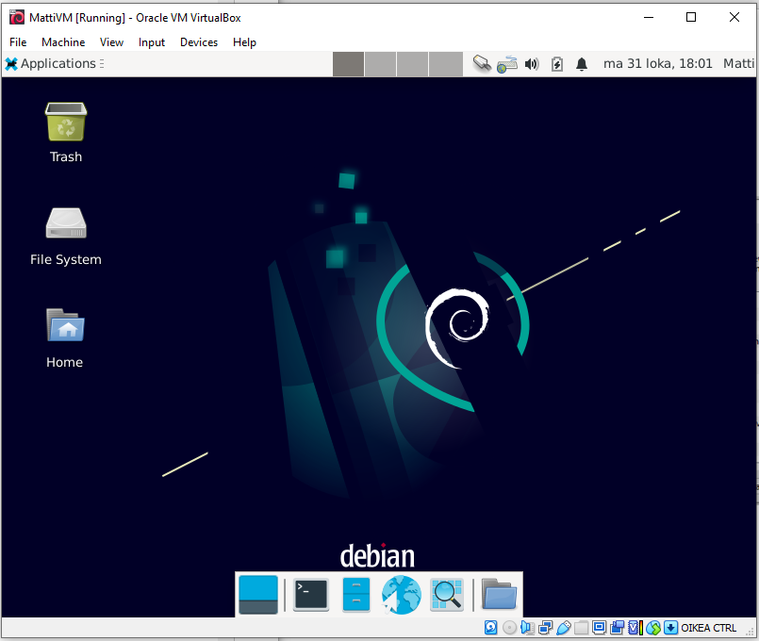
Login into Debian
There where some issues login
After restarting the logging works

Slide 9
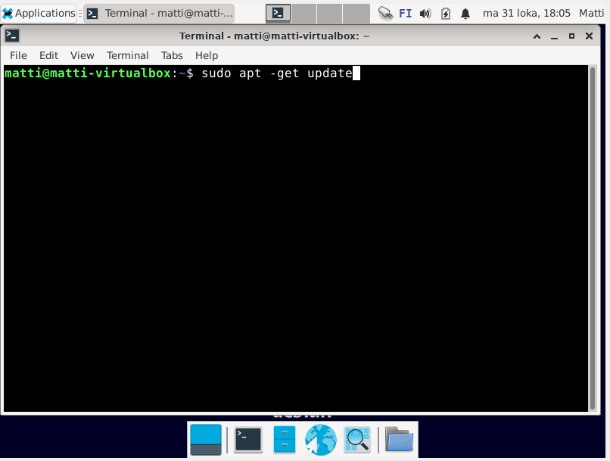
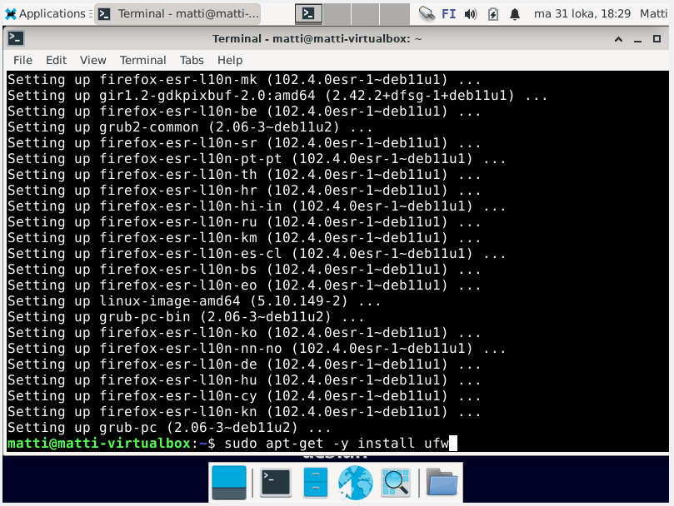
Sudo updates and firewall settings

Slide 10
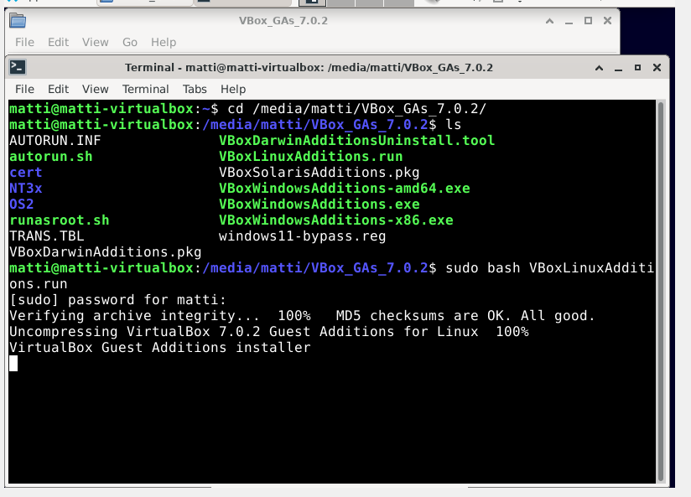
Guest additions for good resolution

Slide 11
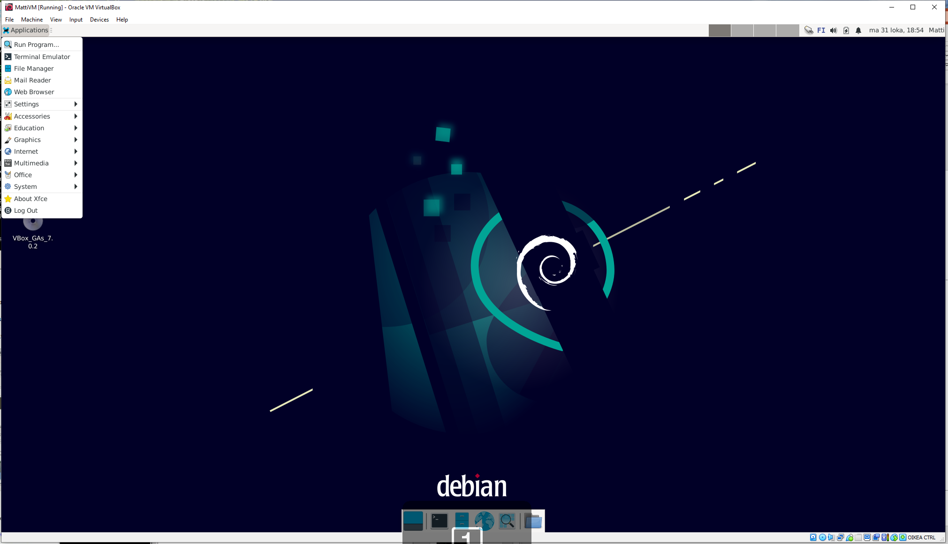
Big screen

